Slide 1
CHAPTER 4
Operations on Data

Slide 2
Objectives
After studying this chapter, the student should be able to:
List the three categories of operations performed on data.
Perform unary and binary logic operations on bit patterns.
Distinguish between logic shift operations and arithmetic shift operations.
Perform logic shift operations on bit patterns.
Understand some applications of logic and shift operations such as setting, unsetting, and flipping bits.
Perform addition and subtraction on integers when they are stored in two’s complement format.

Slide 3
4-1 LOGIC OPERATIONS
In Chapter 3 we discussed the fact that data inside a computer is stored as patterns of bits. Logic operations refer to those operations that apply the same basic operation on individual bits of a pattern, or on two corresponding bits in two patterns. This means that we can define logic operations at the bit level and at the pattern level. A logic operation at the pattern level is n logic operations, of the same type, at the bit level where n is the number of bits in the pattern.

Slide 4
4.1.1 Logic operations at bit level
A bit can take one of the two values: 0 or 1. If we interpret 0 as the value false and 1 as the value true, we can apply the operations defined in Boolean algebra to manipulate bits. Boolean algebra, named in honor of George Boole, belongs to a special field of mathematics called logic. Boolean algebra and its application to building logic circuits in computers are briefly discussed in Appendix E. In this section, we show briefly four bit-level operations that are used to manipulate bits: NOT, AND, OR, and XOR.
Boolean algebra and logic circuits are discussed in Appendix E.

Slide 5
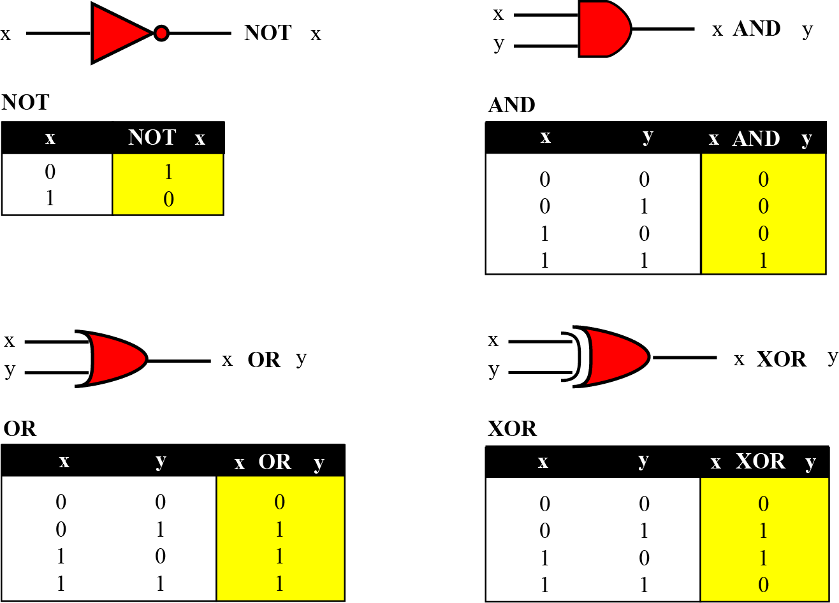
Figure 4.1 Logic operations at the bit level

Slide 6
NOT
The NOT operator is a unary operator: it takes only one input. The output bit is the complement of the input.
AND
The AND operator is a binary operator: it takes two inputs. The output bit is 1 if both inputs are 1s and the output is 0 in the other three cases.
For x = 0 or 1 x AND 0 → 0 0 AND x → 0

Slide 7
OR
The OR operator is a binary operator: it takes two inputs. The output bit is 0 if both inputs are 0s and the output is 1 in other three cases.
For x = 0 or 1 x OR 1 → 1 1 OR x → 1
XOR
The XOR operator is a binary operator like the OR operator, with only one difference: the output is 0 if both inputs are 1s.
For x = 0 or 1 1 XOR x → NOTx 1 XOR x → 1

Slide 8
Example 4.1
In English we use the conjunction “or” sometimes to mean an inclusive-or, and sometimes to mean an exclusive-or.
The sentence “I wish to have a car or a house” uses “or” in the inclusive sense—I wish a car, a house, or both.
The sentence “Today is either Monday or Tuesday” uses “or” in the exclusive sense—today is either Monday or Tuesday, but it cannot be both.

Slide 9
Example 4.2
The XOR operator is not actually a new operator. We can always simulate it using the other three operators. The following two expressions are equivalent
x XOR y ↔ [x AND (NOT y)] OR [(NOT x) AND y]
The equivalence can be proved if we make the truth table for both.

Slide 10
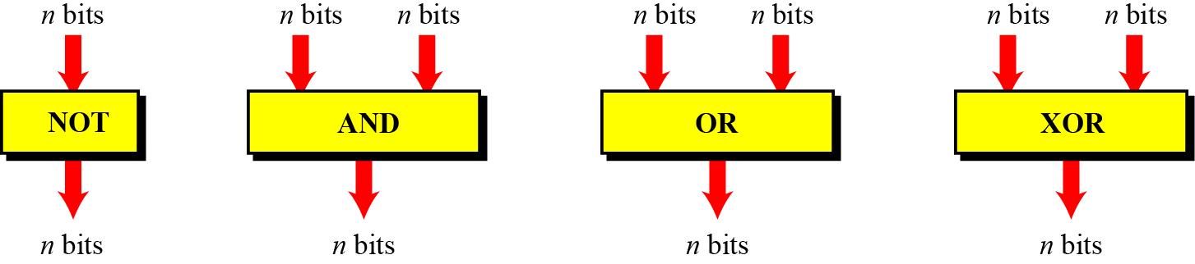
4.1.2 Logic operations at pattern level
The same four operators (NOT, AND, OR, and XOR) can be applied to an n-bit pattern. The effect is the same as applying each operator to each individual bit for NOT and to each corresponding pair of bits for other three operators. Figure 4.2 shows these four operators with input and output patterns.
Figure 4.2 Logic operators applied to bit patterns

Slide 11
Example 4.3
Use the NOT operator on the bit pattern 10011000.
Solution
The solution is shown below. Note that the NOT operator changes every 0 to 1 and every 1 to 0.

Slide 12
Example 4.4
Use the AND operator on the bit patterns 10011000 and 00101010.
Solution
The solution is shown below. Note that only one bit in the output is 1, where both corresponding inputs are 1s.

Slide 13
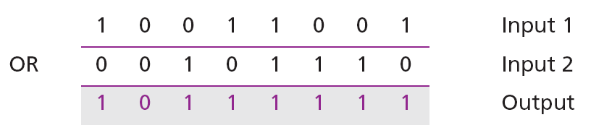
Example 4.5
Use the OR operator on the bit patterns 10011001 and 00101110.
Solution
The solution is shown below. Note that only one bit in the output is 0, where both corresponding inputs are 0s.

Slide 14
Example 4.6
Use the XOR operator on the bit patterns 10011001 and 00101110.
Solution
The solution is shown below. Compare the output in this example with the one in Example 4.5. The only difference is that when the two inputs are 1s, the result is 0 (the effect of exclusion).

Slide 15
Applications
The four logic operations can be used to modify a bit pattern.
Complementing (NOT)
Unsetting (AND)
Setting (OR)
Flipping (XOR)

Slide 16
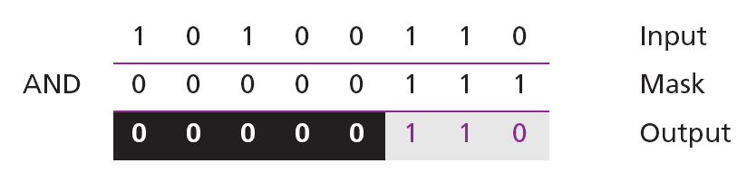
Example 4.7
Use a mask to unset (clear) the five leftmost bits of a pattern. Test the mask with the pattern 10100110.
Solution
The mask is 00000111. The result of applying the mask is:

Slide 17
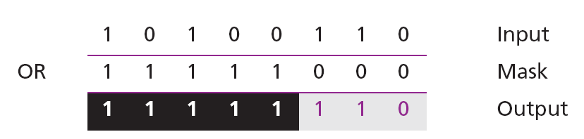
Example 4.8
Use a mask to set the five leftmost bits of a pattern. Test the mask with the pattern 10100110.
Solution
The mask is 11111000. The result of applying the mask is:

Slide 18
Example 4.9
Use a mask to flip the five leftmost bits of a pattern. Test the mask with the pattern 10100110.
Solution
The mask is 11111000. The result of applying the mask is:

Slide 19
4-2 SHIFT OPERATIONS
Shift operations move the bits in a pattern, changing the positions of the bits. They can move bits to the left or to the right. We can divide shift operations into two categories: logical shift operations and arithmetic shift operations.

Slide 20
4.2.1 Logical shift operations
A logical shift operation is applied to a pattern that does not represent a signed number. The reason is that these shift operation may change the sign of the number that is defined by the leftmost bit in the pattern. We distinguish two types of logical shift operations, as described below:
Simple shift
Circular shift (Rotate)

Slide 21
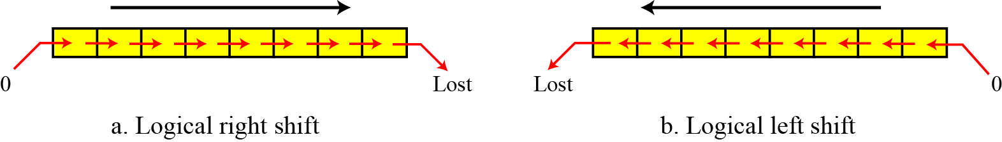
Figure 4.3 Logical shift operations

Slide 22
Example 4.10
Use a logical left shift operation on the bit pattern 10011000.
Solution
The solution is shown below. The leftmost bit is lost and a 0 is inserted as the rightmost bit.
Discarded
Added

Slide 23
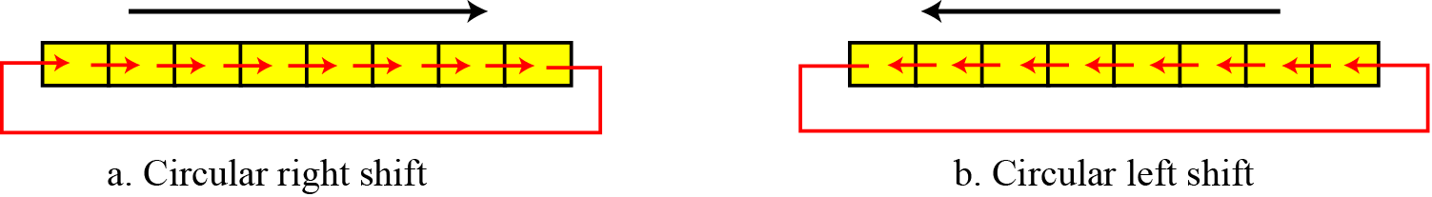
Figure 4.4 Circular shift operations

Slide 24
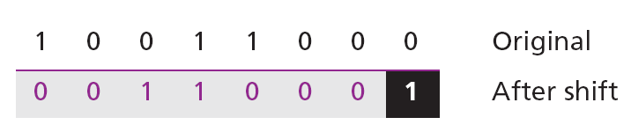
Example 4.11
Use a circular left shift operation on the bit pattern 10011000.
Solution
The solution is shown below. The leftmost bit is circulated and becomes the rightmost bit.

Slide 25
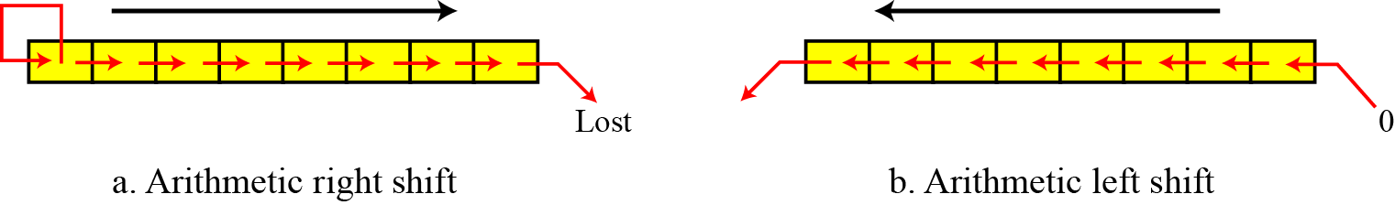
4.2.2 Arithmetic shift operations
Arithmetic shift operations assume that the bit pattern is a signed integer in two’s complement format. Arithmetic right shift is used to divide an integer by two, while arithmetic left shift is used to multiply an integer by two.
Figure 4.5 Arithmetic shift operations

Slide 26
Example 4.12
Use an arithmetic right shift operation on the bit pattern 10011001. The pattern is an integer in two’s complement format.
Solution
The solution is shown below. The leftmost bit is retained and also copied to its right neighbour bit.
The original number was −103 and the new number is −52, which is the result of dividing −103 by 2 truncated to the smaller integer.

Slide 27
Example 4.13
Use an arithmetic left shift operation on the bit pattern 11011001. The pattern is an integer in two’s complement format.
Solution
The solution is shown below. The leftmost bit is lost and a 0 is inserted as the rightmost bit.
The original number was −39 and the new number is −78. The original number is multiplied by two. The operation is valid because no underflow occurred.

Slide 28
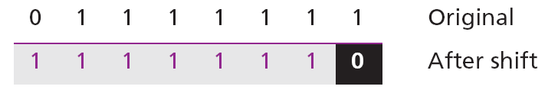
Example 4.14
Use an arithmetic left shift operation on the bit pattern 01111111. The pattern is an integer in two’s complement format.
Solution
The solution is shown below. The leftmost bit is lost and a 0 is inserted as the rightmost bit.
The original number was 127 and the new number is −2. Here the result is not valid because an overflow has occurred. The expected answer 127 × 2 = 254 cannot be represented by an 8-bit pattern.

Slide 29
4-3 ARITHMETIC OPERATIONS
Arithmetic operations involve adding, subtracting, multiplying, and dividing. We can apply these operations to integers and floating-point numbers.

Slide 30
4.3.1 Arithmetic operations on integers
All arithmetic operations such as addition, subtraction, multiplication, and division can be applied to integers. Although multiplication (division) of integers can be implemented using repeated addition (subtraction), the procedure is not efficient. There are more efficient procedures for multiplication and division, such as Booth procedures, but these are beyond the scope of this book. For this reason, we only discuss addition and subtraction of integers here.

Slide 31
Two’s complement integers
When the subtraction operation is encountered, the computer simply changes it to an addition operation, but makes two’s complement of the second number. In other words:
A − B ↔ A + (B + 1)
Where B is the one’s complement of B and (B + 1) means the two’s complement of B

Slide 32
We should remember that we add integers column by column. The following table shows the sum and carry (C).

Slide 33
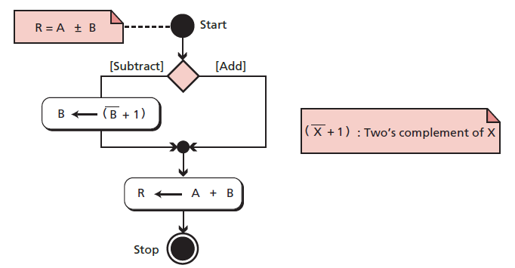
Figure 4.6 Addition and subtraction of integers in two’s complement
The procedure is as follows:
1. If the operation is subtraction, we take the two’s complement of the second integer.
Otherwise, we move to the next step.
2. We add the two integers.

Slide 34
Example 4.16
Two integers A and B are stored in two’s complement format. Show how B is added to A.
A = (00010001)₂ B = (00010110)₂
Solution
The operation is adding. A is added to B and the result is stored in R. We check the result in decimal: (+17) + (+22) = (+39).

Slide 35
Example 4.17
Two integers A and B are stored in two’s complement format. Show how B is added to A.
A = (00011000)₂ B = (11101111)₂
Solution
The operation is adding. A is added to B and the result is stored in R. We check the result in decimal: (+24) + (−17) = (+7).

Slide 36
Example 4.18
Two integers A and B are stored in two’s complement format. Show how B is subtracted from A.
A = (00011000)₂ B = (11101111)₂
Solution
The operation is subtracting. A is added to (B + 1) and the result is stored in R. We check the result in decimal: (+24) − (−17) = (+41).

Slide 37
Example 4.19
Two integers A and B are stored in two’s complement format. Show how B is subtracted from A.
A = (11011101)₂ B = (00010100)₂
Solution
The operation is subtracting. A is added to (B + 1) and the result is stored in R. We check the result in decimal: (−35) − (+20) = (−55).

Slide 38
Example 4.20
Two integers A and B are stored in two’s complement format. Show how B is added to A.
A = (01111111)₂ B = (00000011)₂
Solution
The operation is adding. A is added to B and the result is stored in R.
We expect the result to be 127 + 3 = 130, but the answer is −126. The error is due to overflow, because the expected answer (+130) is not in the range −128 to +127.

Slide 39
When we do arithmetic operations on numbers in a computer, we should remember that each number and the result should be in the range defined by
the bit allocation.

Slide 40
sign-and-magnitude integers
Addition and subtraction for integers in sign-and-magnitude representation looks very complex. We have four different combination of signs (two signs, each of two values) for addition, and four different conditions for subtraction. This means that we need to consider eight different situations. For those interested readers, we describe these in more detail in Appendix I.

Slide 41
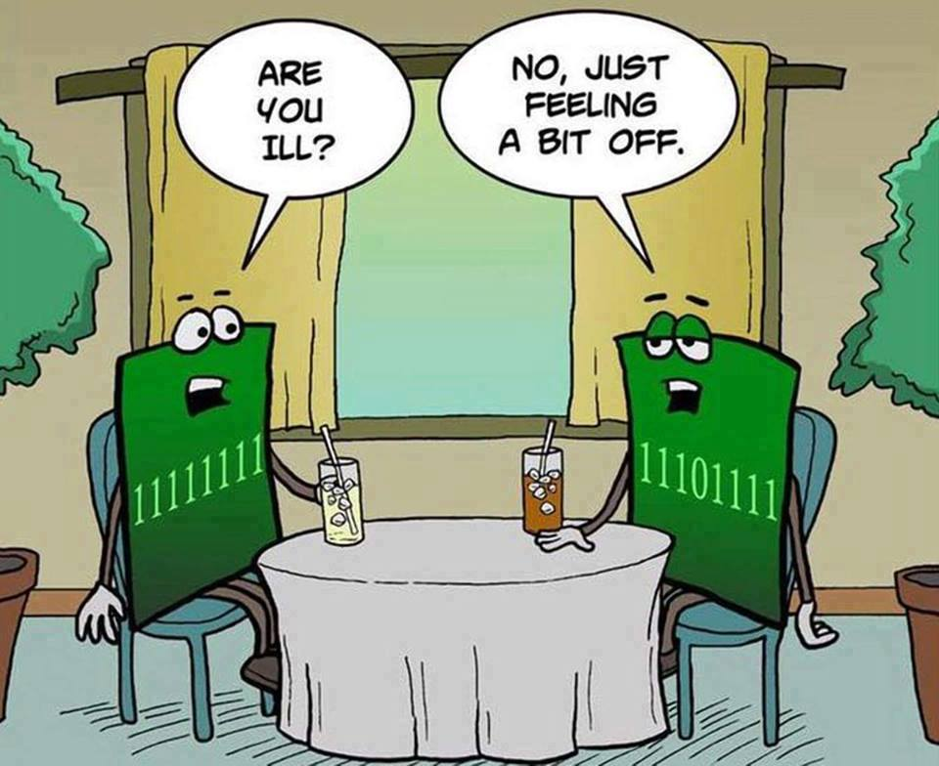
The End

